Slide 1
Database Systems
Lecture 8
Entity Relationship (ER) Data Model

Slide 2
Today’s agenda
Using high-level conceptual data models for database design
Entity Relationship (ER) Data Model
Example Company database
Constructs in ER data models
Types of Attributes

Slide 3
Using High-Level Conceptual Data Models for Database Design
Requirements collection and analysis
Understand and document their data requirements
In parallel with data requirements specify the known functional requirements
Consists of user-defined operations or transactions including both retrieval and update
Create a conceptual schema for the database
Conceptual design

Slide 4
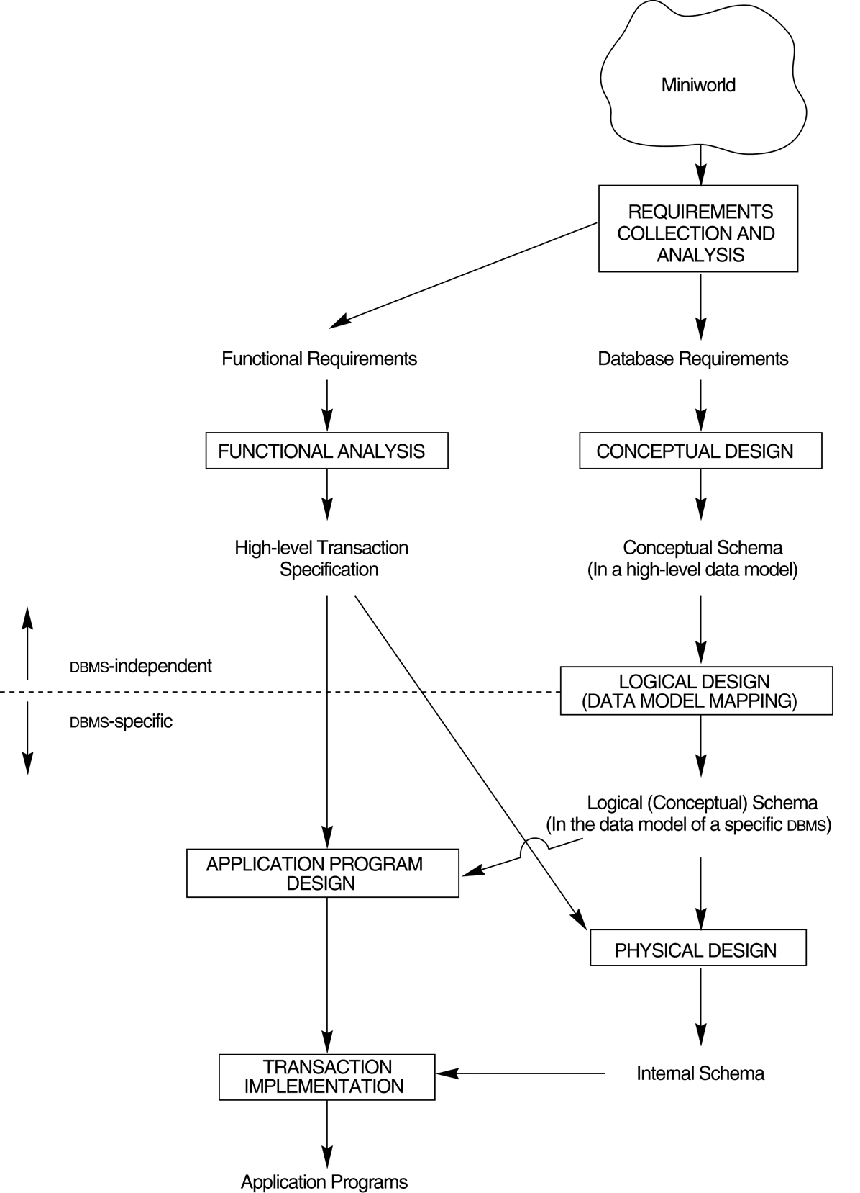
Using High-Level Conceptual Data Models for Database Design

Slide 5
Using High-Level Conceptual Data Models for Database Design
During or after conceptual schema design, specify the high-level user operations identified during functional analysis
Conceptual schema can be modified if some functional requirements are not meet
Next is the actual implementation of the database using a commercial DBMS (i.e., transformation from high-level data model into implementation model)
Using relational or object-relational models
Also called Logical design or data model mapping
Physical design (internal storage structure, file organization, indexes, access paths, physical design parameters are specified)
In parallel, application programs are designed

Slide 6
Entity-Relationship (ER) Data Model
Conceptual Design
Semantic data model that is used for the graphical representation of the conceptual database design
A database ‘schema’ in the ER Model can be represented pictorially (ER diagrams).
Can map an ER diagram into a relational schema.

Slide 7
Example COMPANY Database
Requirements of the Company (oversimplified for illustrative purposes)
The company is organized into DEPARTMENTs. Each department has a name, number and an employee who manages the department. We keep track of the start date of the department manager.
Each department controls a number of PROJECTs. Each project has a name, number and is located at a single location.

Slide 8
Example COMPANY Database (Cont.)
We store each EMPLOYEE’s social security number, address, salary, sex, and birthdate. Each employee works for one department but may work on several projects. We keep track of the number of hours per week that an employee currently works on each project. We also keep track of the direct supervisor of each employee.
Each employee may have a number of DEPENDENTs. For each dependent, we keep track of their name, sex, birthdate, and relationship to employee.

Slide 9
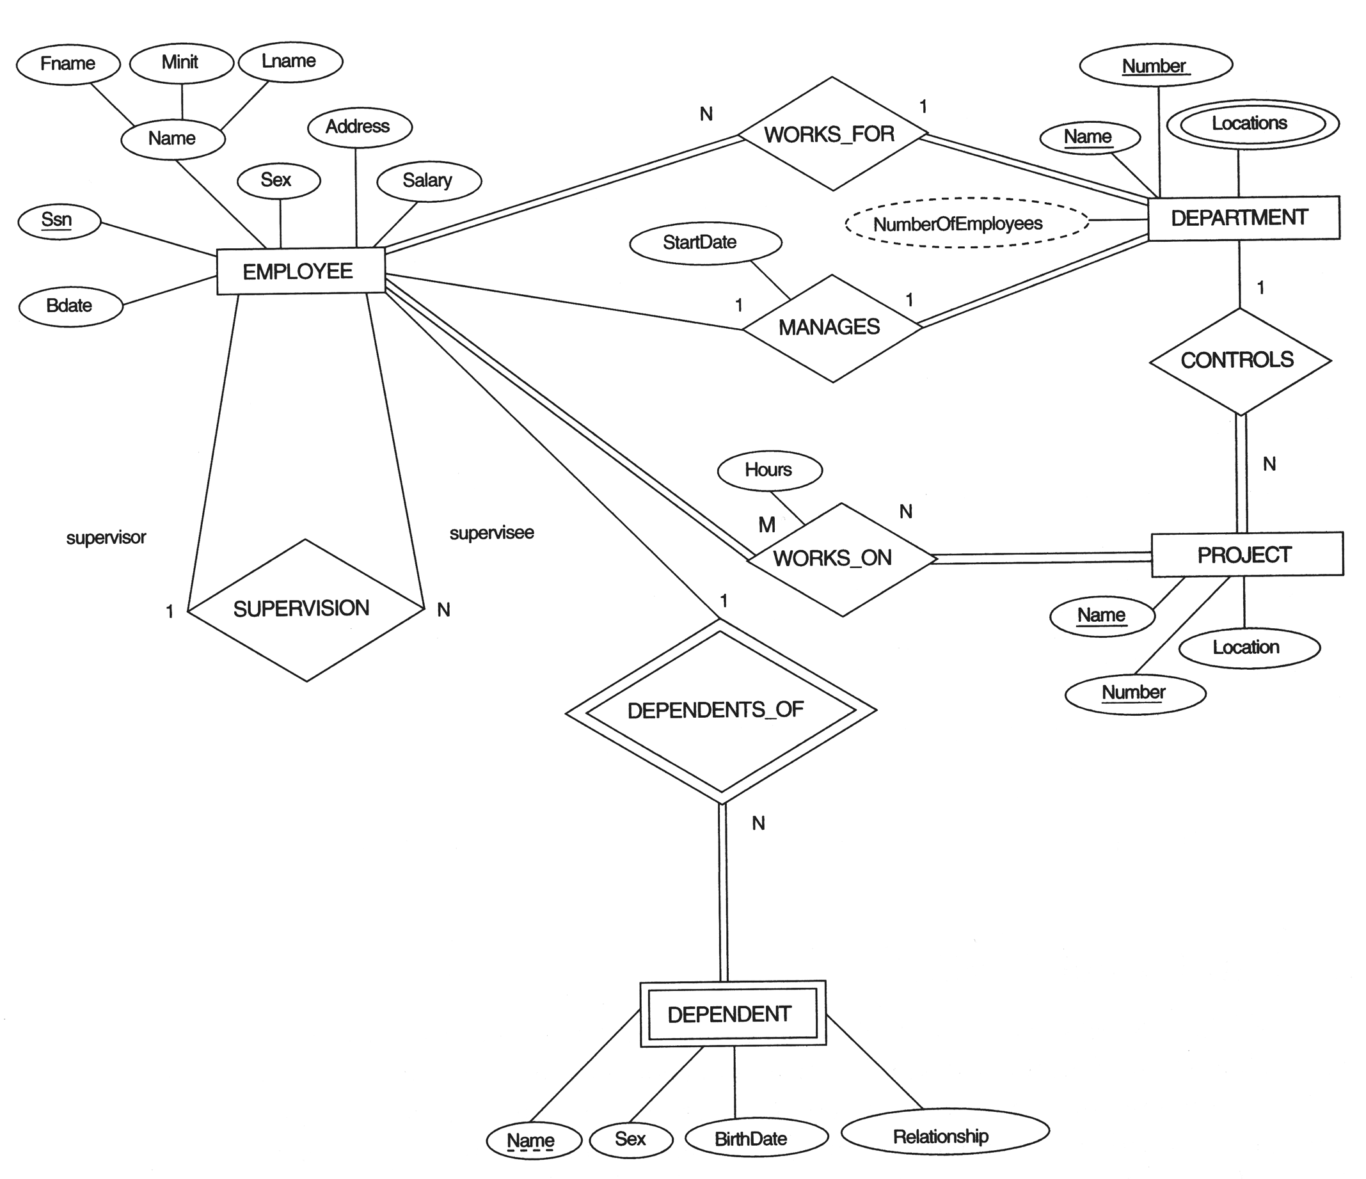
An ER schema diagram for the COMPANY database

Slide 10
Constructs in ER Data Model
The E-R data model supports following major constructs:
Entity
Attribute
Relationship

Slide 11
Entities
Real-world object which is distinguishable from other objects.
Entity may have physical or conceptual existence.
Entities are specific objects or things in the mini-world that are represented in the database. For example the EMPLOYEE John Smith, the Research DEPARTMENT, the ProductX PROJECT
A specific entity will have a value for each of its attributes. For example a specific employee entity may have Name='John Smith', SSN='123456789', Address ='731, Fondren, Houston, TX', Sex='M', BirthDate='09-JAN-55‘

Slide 12
Attributes
Attributes are properties used to describe an entity. For example an EMPLOYEE entity may have a Name, SSN, Address, Sex, BirthDate
An entity is described (in DB) using a set of attributes
Each attribute has a value set (or data type) associated with it – e.g. integer, string, enumerated type, …

Slide 13
Relationships
Association among two or more entities. E.g., Ahmad works in Pharmacy department.

Slide 14
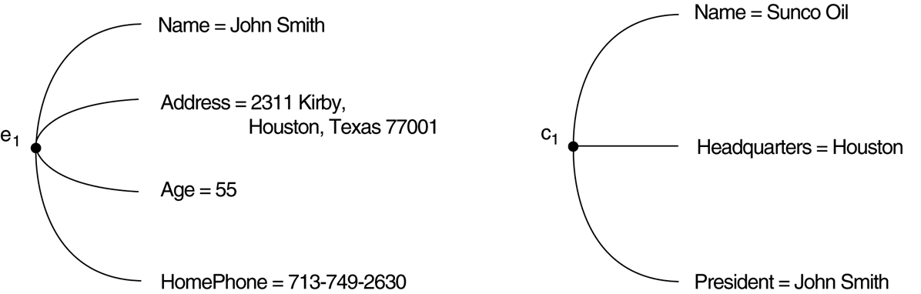
Two entities, employee e₁ and company c₁, and their attributes

